Slide 1
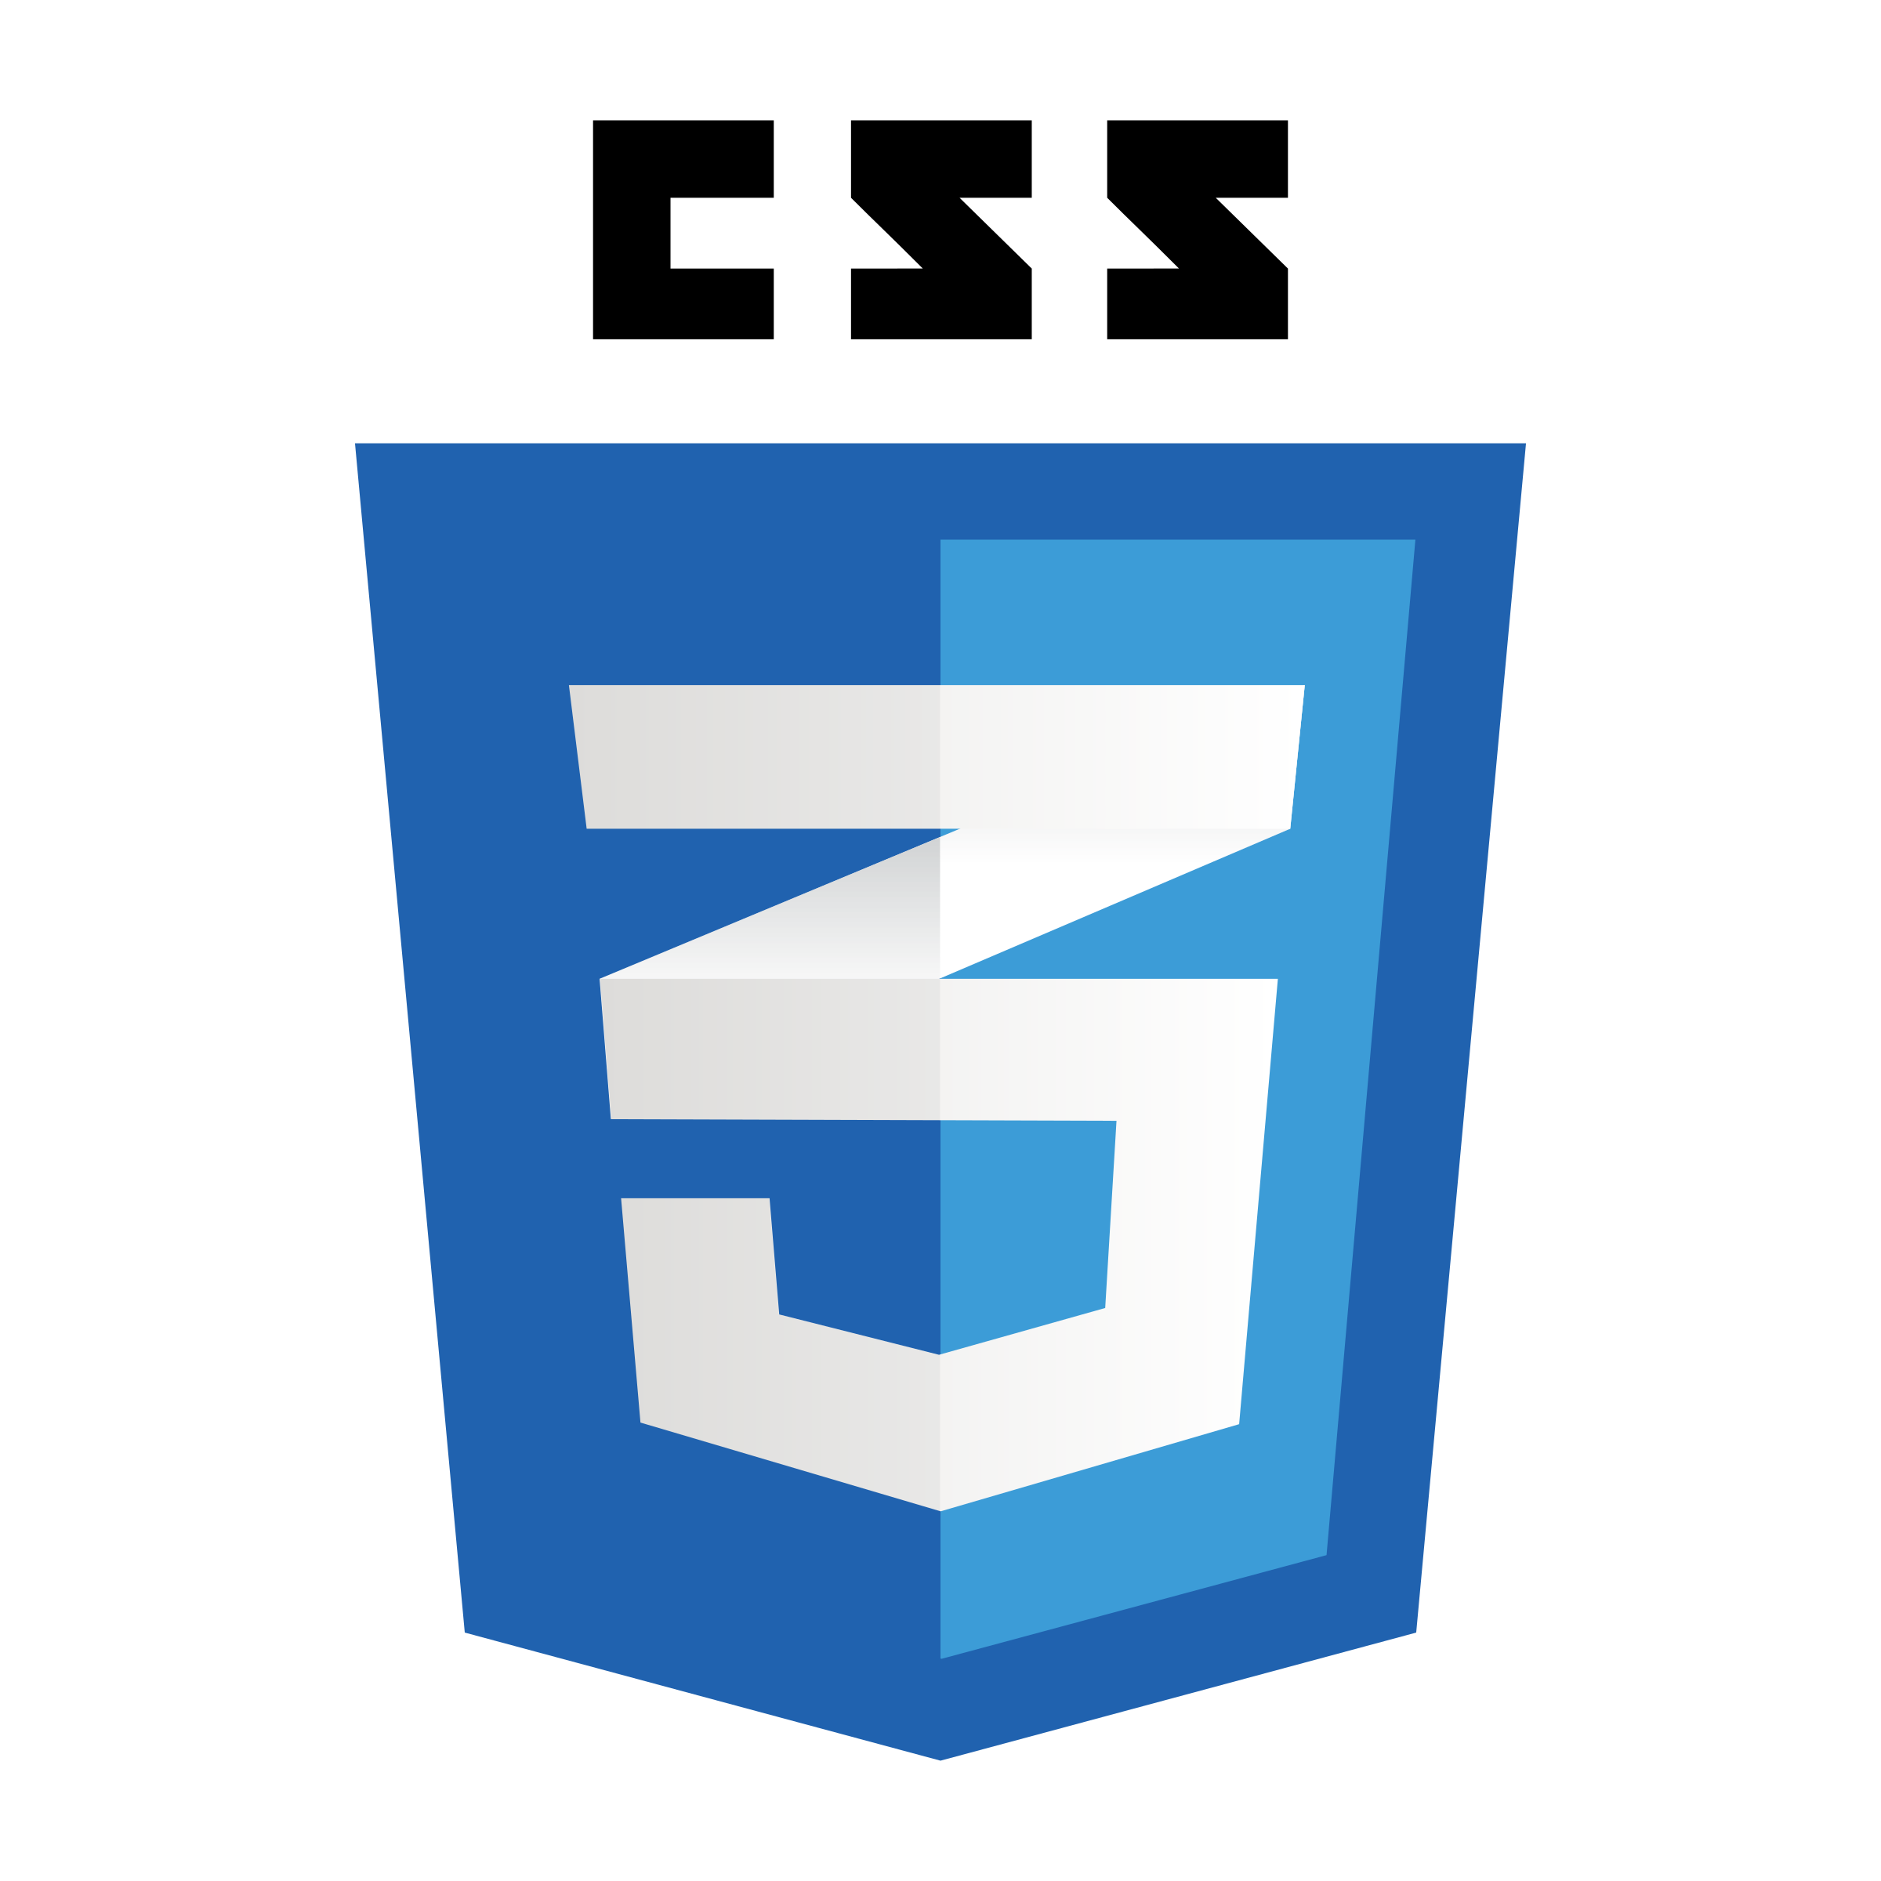
Floating Elements

Slide 2

The CSS float property (reference)
img.headericon {
float: right; width: 130px;
} CSS
Ghostbusters is a 1984 American science fiction comedy
film written by co-stars Dan Aykroyd and Harold Ramis
about three eccentric New York City parapsychologists
turned ghost capturers.
output
property | description
float | side to hover on; can be left, right, or none (default)
removed from normal document flow; underlying text wraps around as necessary

Slide 3
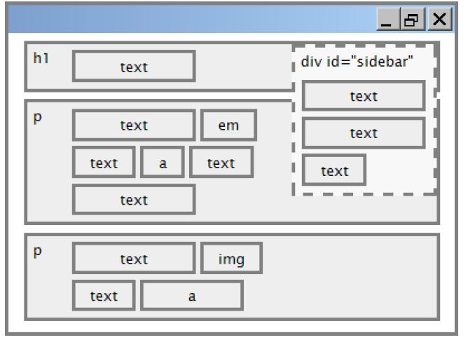
Floating elements diagram

Slide 4
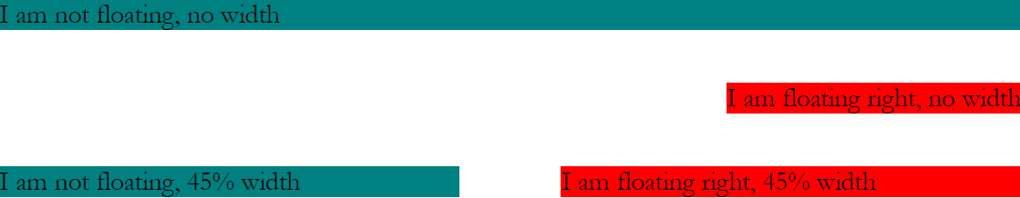
Common float bug: missing width
often floating block elements must have a width property value
Let’s try “floating”
Notes:
if no width is specified, the floating element may occupy 100% of the page width, so no content can wrap around it

Slide 5
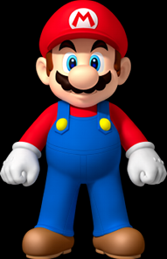
The clear property
p { background-color: fuchsia; }
h2 { clear: right; background-color: yellow; } CSS
Mario is a fictional character in his video game series.
Serving as Nintendo's mascot and the main protagonist
of the series, Mario has appeared in over 200 video
games since his creation.
output
Mario is a fictional character in his video game series. Serving as Nintendo's mascot and the main protagonist of the series, Mario has appeared in over 200 video games since his creation.
Super Mario Fan Site!

Slide 6

The clear property (cont.)
property | description
clear | disallows floating elements from overlapping this element; can be left, right, or none (default)
Let’s try “clear”

Slide 7
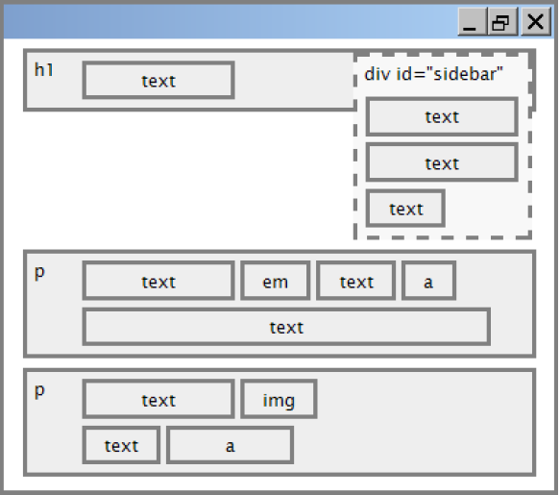
Clear diagram
div#sidebar { float: right; }
p { clear: right; } CSS

Slide 8
Common error: container too short
<p><img src="images/mario.png" alt=“super mario" />
Mario is a fictional character in his video game series.....</p> HTML
p { border: 2px dashed black; }
img { float: right; } CSS
Mario is a fictional character in his video game series.
Serving as Nintendo's mascot and the main protagonist
of the series, Mario has appeared in over 200 video
games since his creation.
output
Notes:
We want the p containing the image to extend downward so that its border encloses the entire image

Slide 9
The overflow property
p { border: 2px dashed black;
overflow: hidden; } CSS
Mario is a fictional character in his video game series.
Serving as Nintendo's mascot and the main protagonist
of the series, Mario has appeared in over 200 video
games since his creation.
output
Notes:
We want the p containing the image to extend downward so that its border encloses the entire image

Slide 10
The overflow property (cont.)
property | description
overflow | specifies what to do if an element's content is too large; can be auto, visible, hidden, or scroll
Notes:
We want the p containing the image to extend downward so that its border encloses the entire image

Slide 11
Multi-column layouts
<div>
<p>first paragraph</p>
<p>second paragraph</p>
<p>third paragraph</p>
Some other text that is important
</div> HTML
p { float: right; width: 25%; margin: 0.5em;
border: 2px solid black; }
div { border: 3px dotted green; overflow: hidden; } CSS
Some other text that is important
output
third paragraph
second paragraph
first paragraph
Notes:
We want the p containing the image to extend downward so that its border encloses the entire image

Slide 12
Sizing and Positioning

Slide 13
The position property (examples)
div#ad {
position: fixed;
right: 10%;
top: 45%;
} CSS
property | value | description
position | static | default position
 | relative | offset from its normal static position
 | absolute | a fixed position within its containing element
 | fixed | a fixed position within the browser window
top, bottom, left, right | positions of box's corners

Slide 14
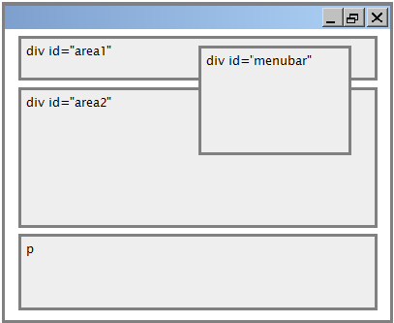
Absolute positioning
#menubar {
position: absolute;
left: 400px;
top: 50px;
} CSS
removed from normal flow
positioned relative to the block
element containing them
actual position determined by
top, bottom, left, right
should often specify a width
property as well

Slide 15
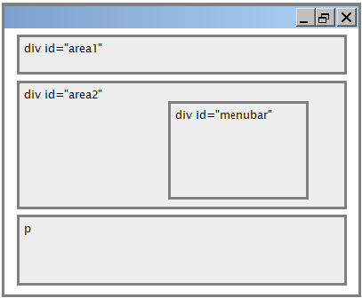
Relative positioning
#area2 { position: relative; } CSS
absolute-positioned elements are normally positioned at an offset from the corner of the overall web page
to make the absolute element to position itself relative to some other element's corner, wrap the absolute element in an element whose position is relative
Notes:
How will the html code look?

Slide 16
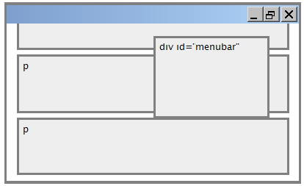
Fixed positioning
#area2 { position: relative; } CSS
removed from normal flow
positioned relative to the browser window even when the user scrolls the window, element will remain in the same place
Notes:
How will the html code look?

Slide 17
Alignment vs. float vs. position
If possible, lay out an element by aligning its content
horizontal alignment: text-align
set this on a block element; it aligns the content within it (not the block element itself)
vertical alignment: vertical-align
set this on an inline element, and it aligns it vertically within its containing element
If alignment won't work, try floating the element
If floating won't work, try positioning the element
absolute/fixed positioning are a last resort and should not be overused
Notes:
Find a good example or w3c

Slide 18
Details about inline boxes
Size properties (width, height, min-width, etc.) are ignored for inline boxes
margin-top and margin-bottom are ignored,
but margin-left and margin-right are not ignored

Slide 19
Details about inline boxes
the containing block box's text-align property controls horizontal position of inline boxes within it
text-align does not align block boxes within the page
each inline box's vertical-align property aligns it vertically within its block box
Notes:
Definitely an example here is needed

Slide 20
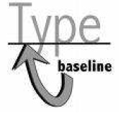
The vertical-align property
property | description
vertical-align | specifies where an inline element should be aligned vertically, with respect to other content on the same line within its block element's box
can be top, middle, bottom, baseline (default), sub, super, text-top, text-bottom, or a length value or %
baseline means aligned with bottom of non-hanging letters
Notes:
Book is not up to date here. CSS vertical-align property (w3schools.com)

Slide 21
vertical-align example
<p style="background-color: yellow;">
<span style="vertical-align: top; border: 1px solid red;">
Don't be sad! Turn that frown
<img src="images/sad.jpg" alt="sad" /> upside down!
<img style="vertical-align: bottom“ src="images/smiley.jpg" alt="smile" />
Smiling burns calories, you know.
<img style="vertical-align: middle" src="images/puppy.jpg" alt="puppy" /> Anyway, look at this cute puppy; isn't he adorable! So cheer up, and have a nice day. The End.
</span>
</p> HTML

Slide 22

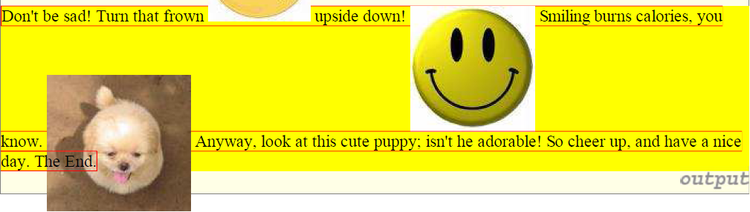
vertical-align example (cont.)

Slide 23

Common bug: space under image
<p style="background-color: red; padding: 0px; margin: 0px">
<img src="images/smiley.png" alt="smile" />
</p> HTML
red space under the image, despite padding and margin of 0
this is because the image is vertically aligned to the baseline of the paragraph (not the same as the bottom)
setting vertical-align to bottom fixes the problem (so does setting line-height to 0px)

Slide 24
The display property
h2 { display: inline; background-color: yellow; } CSS
output
property | description
display | sets the type of CSS box model an element is displayed with
values: none, inline, block, run-in, compact, ...
use sparingly, because it can radically alter the page layout

Slide 25
The display property (cont.)
p.secret {
visibility: hidden;
} CSS
output
hidden elements will still take up space onscreen, but will not be shown
to make it not take up any space, set display to none instead
can be used to show/hide dynamic HTML content on the page in response to events

Slide 26

The display property
<ul id="topmenu">
<li>Item 1</li>
<li>Item 2</li>
<li>Item 3</li>
</ul> HTML
#topmenu li {
display: inline;
border: 2px solid gray;
margin-right: 1em;
} CSS
output
lists and other block elements can be displayed inline
flow left-to-right on same line
width is determined by content

